Slide 1




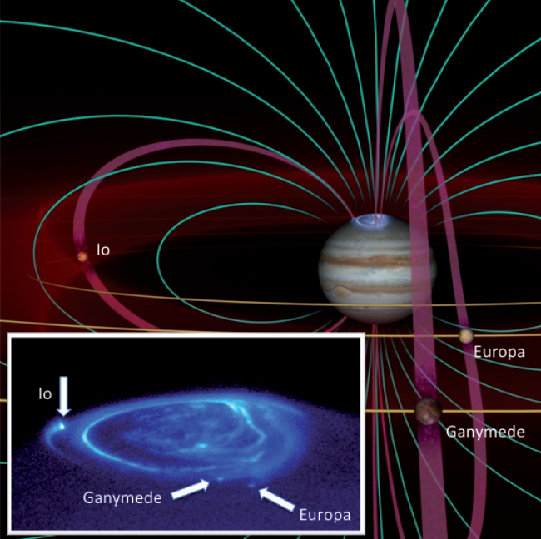
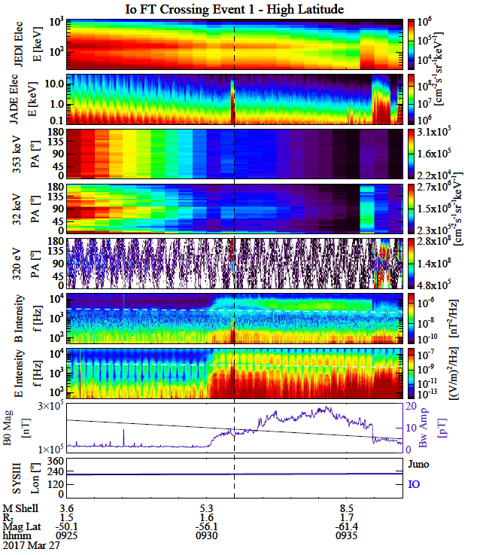
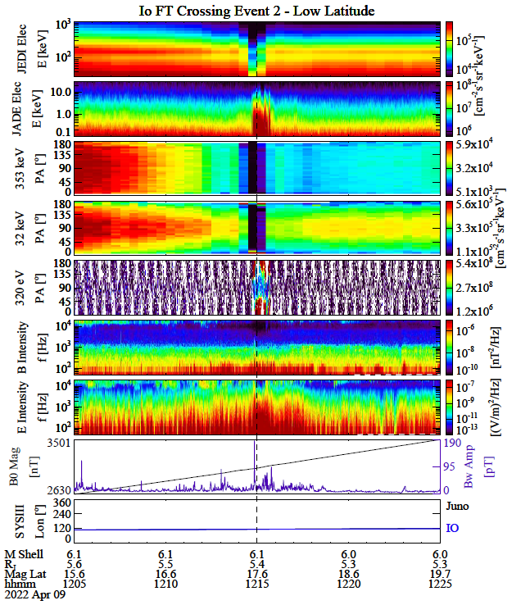
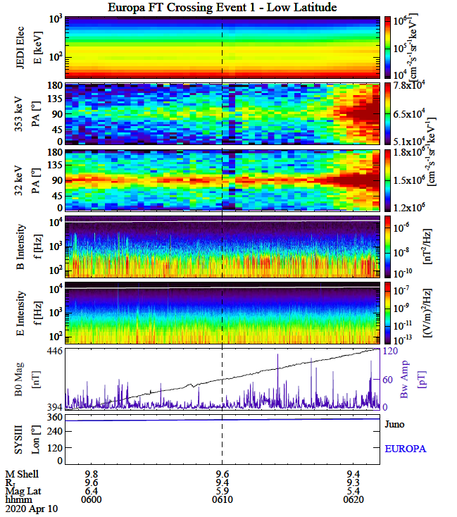
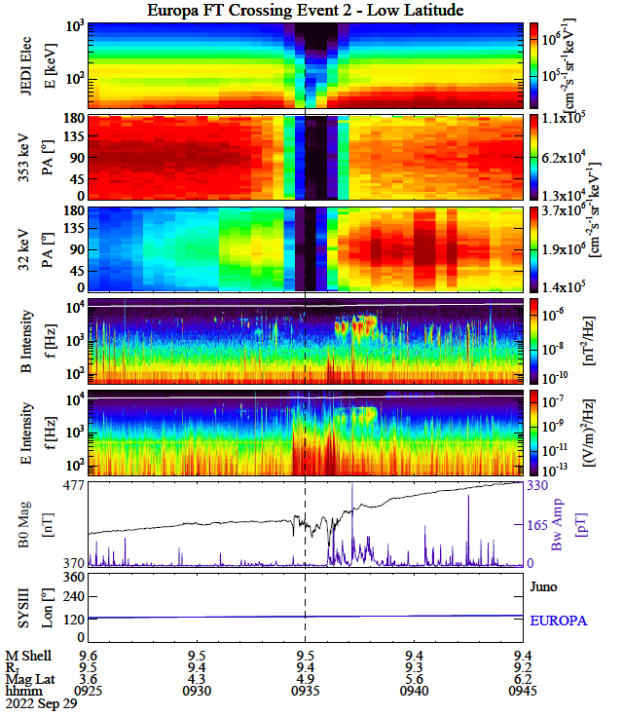
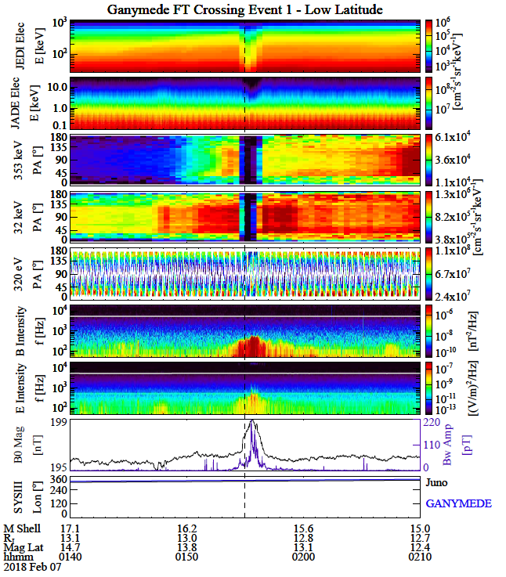
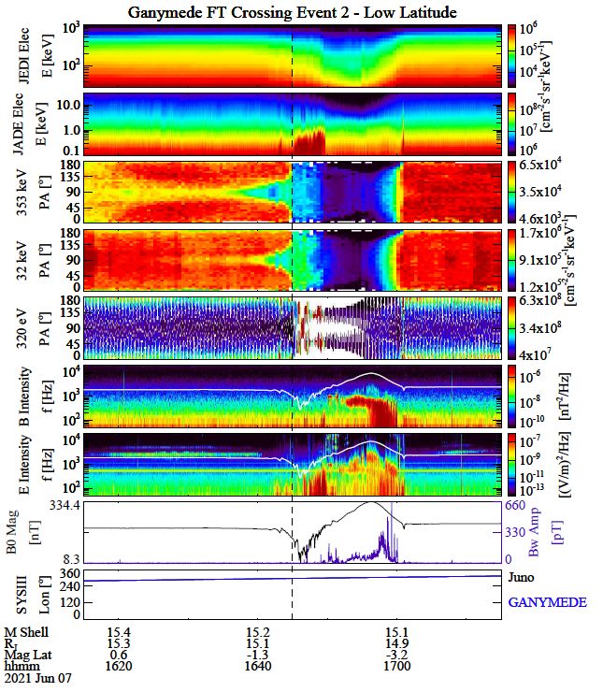
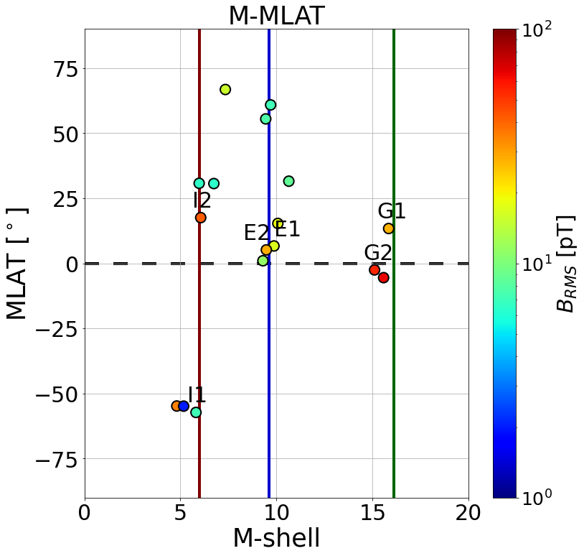
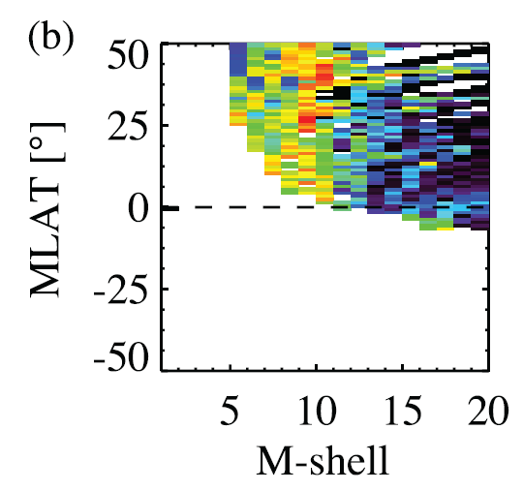
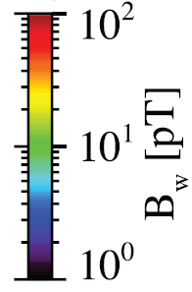
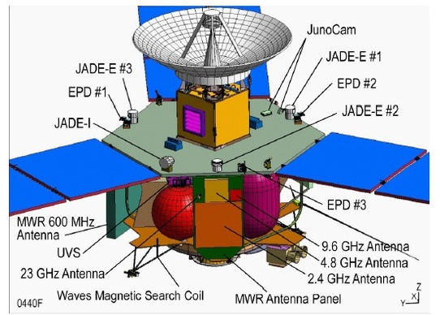
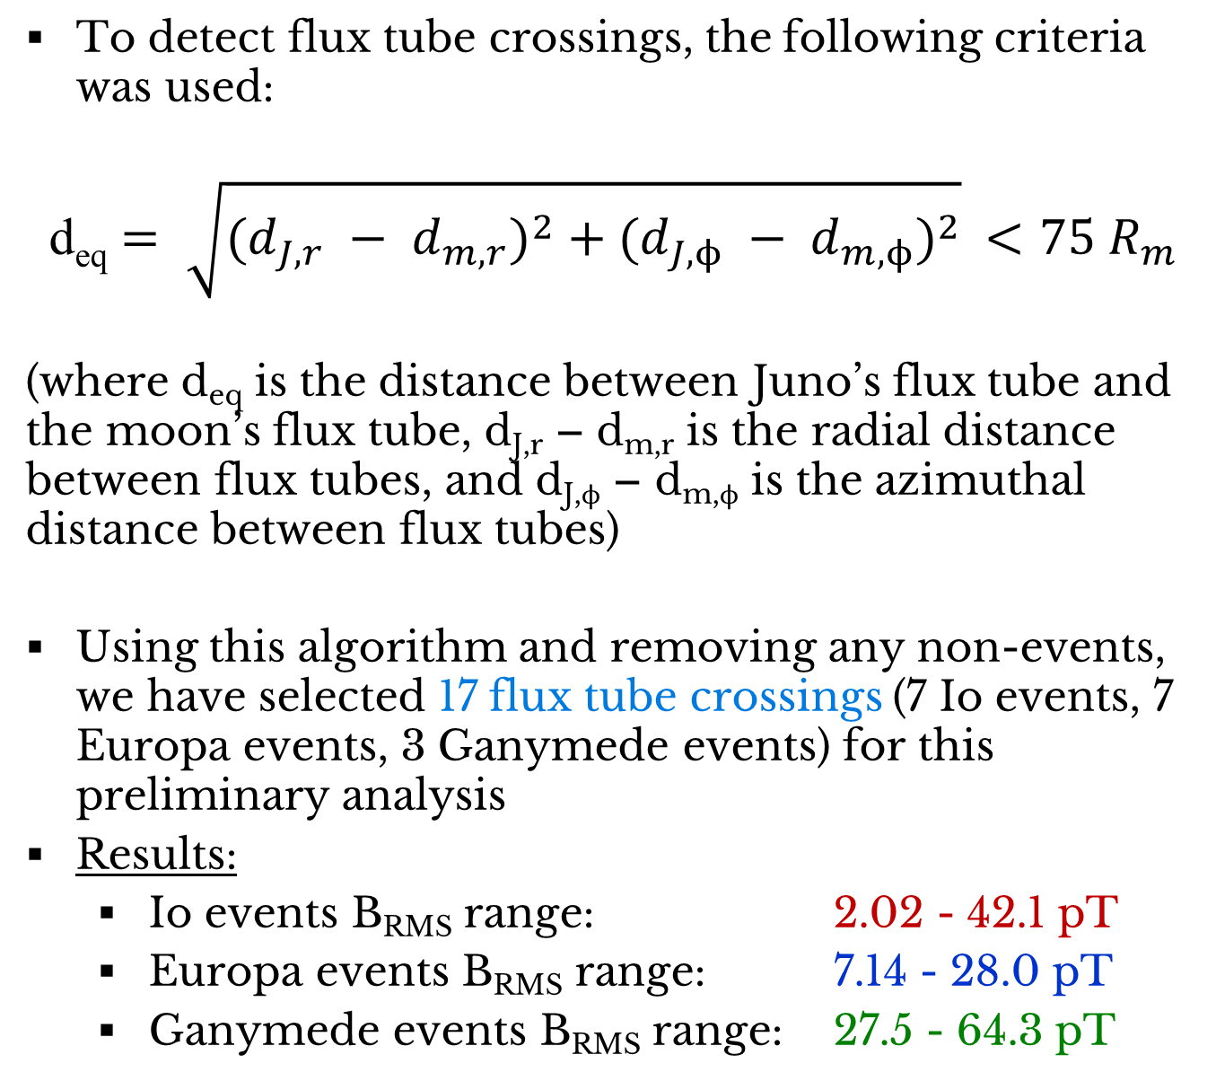
Unveiling the effects of the Galilean moons on whistler mode waves and energetic particles at Jupiter
Conrad Meyer-Reed ¹, Wen Li ¹, Qianli Ma ^{1,2}, Xiao-Chen Shen ¹, Juno Team
¹Center for Space Physics, Boston University, Boston, MA, U.S.A. | ²University of California Los Angeles, Los Angeles, CA, U.S.A.
email: conradmr@bu.edu
1. Background
4. Events Study
Ganymede Flux Tube Crossings
Interactions between the Galilean moons and plasma torus in Jupiter’s equatorial region cause instabilities that generate plasma wave growth.
Whistler mode waves have been observed to propagate along flux tubes (FT), accelerating particles along magnetic field lines connecting the Galilean moons to Jupiter’s auroral region.
Auroral emission at the base of each moon’s flux tube indicates that the moons play a role in M-I coupling and energy transport throughout the Jovian magnetosphere.
(a)
Io Flux Tube Crossings
Europa Flux Tube Crossings
(a)
(b)
(a)
(b)
(b)
f_{ce}
f_{ce}
f_{cp}
f_{cp}
f_{ce}
f_{ce}
f_{ce}
f_{ce}
Fig 1. Diagram illustrating the geometry of flux tubes associated with Io, Europa, and Ganymede. UV image of the Jovian aurora shows distinct footprints of the inner three Galilean moons [Saur, 2019]
f_{cp}
f_{cp}
f_{ce}
f_{ce}
Fig 3. Overview plots of JEDI, JADE, WAVES, and MAG data during a) a high latitude Io flux tube crossing event (I1) on March 27, 2017, and b) a low latitude Io flux tube crossing event (I2) on April 9, 2022
Fig 4. Overview plots of JEDI, WAVES, and MAG data during a) a low latitude Europa flux tube crossing event (E1) on April 10, 2020, and b) a low latitude Europa flyby event (E2) on September 29, 2022 (no JADE data)
Fig 5. Overview plots of JEDI, JADE, WAVES, and MAG data during a) a low latitude Ganymede flux tube crossing event (G1) on February 7, 2018, and b) a low latitude Ganymede flyby event (G2) on June 7, 2021 (no high latitude event)
2. Science Goals
Event | Date | MLT | MLAT | M-shell | B_{RMS}
I1 | March 27, 2017 | 16.9 hrs | -57.3° | 5.81 | 7.23 pT
I2 | April 9, 2022 | 19.7 hrs | 17.6° | 6.06 | 42.1 pT
Event | Date | MLT | MLAT | M-shell | B_{RMS}
E1 | April 10, 2020 | 22.8 hrs | 6.69° | 9.87 | 6.45 pT
E2 | September 29, 2022 | 18.8 hrs | 5.19° | 9.47 | 28.0 pT
Event | Date | MLT | MLAT | M-shell | B_{RMS}
G1 | February 7, 2018 | 2.89 hrs | 13.4° | 15.8 | 27.5 pT
G2 | June 7, 2021 | 21.1 hrs | -2.51° | 15.1 | 54.5 pT
What are the properties of whistler mode waves across flux tubes connected to the Galilean moons (e.g., Io, Europa, Ganymede)?
How do electron distributions change across flux tubes connected to the Galilean moons?
Whistler mode wave amplitude is observed to slightly dip on the upstream boundary of the of the Io FT in I1 and I2 but intensifies throughout the FT peaking on the downstream boundary.
Before FT crossings, high energy trapped electron pitch angle distributions (PADs) can be seen. At the onset of FT crossings, enhancements in low energy field-aligned electron PADs are observed. While high energy electron dropouts are observed in I2, such dropouts are notably absent in I1.
Whistler mode wave amplitude during I2 peaks by factor of 10 higher than the peak amplitude during I1.
Unlike Io and Ganymede FT crossings, the E2 flyby indicates a time delay in peak whistler mode wave amplitude by ~2 minutes after the JEDI flux tube signature (electrostatic wave activity during FT crossing)
High energy electron dropouts during E2 flyby are nearly identical to dropouts observed in I2 (no JADE for event)
While Juno is located at similar location in orbit during E1 and E2, E1 shows no FT crossing signatures in the JEDI data.
Whistler mode wave amplitude begins to rapidly change on the upstream boundary of the FT crossing and grows exponentially, peaking at the downstream boundary of the FT.
Before and after FT crossings low energy field-aligned electron PADs are observed. During FT crossings, dropouts in high energy electrons and loss cone distributions in low energy electrons can be seen.
Whistler mode wave root mean squared amplitude in G2 is a factor of ~2 times that of G1, indicating a falloff in whistler mode wave amplitude with magnetic latitude.
3. Juno Instrumentation
The Juno spacecraft has collected particle data (JEDI and JADE instruments), plasma wave data (WAVES), and magnetic field data (MAG) from a highly eccentric orbit around Jupiter from 2016-present:
JEDI: 20-1000 keV electrons at 1s-res
JADE: 0.1-50 keV electrons at 1s-res
WAVES: EM waves (50 Hz – 20 kHz) at 1s-res
MAG: Magnetic field (50 Hz – 20 kHz) at 1s-res
Throughout the mission, there have been many close fly-by passes and FT crossings between the spacecraft and inner three Galilean moons.
By analyzing how particle and wave and data change across FTs, we can quantify the effects of the Galilean moons on the Jovian plasma torus.
5. Statistical Analysis
(a)
6. Conclusions
To detect flux tube crossings, the following criteria was used:
d_{eq} $= \sqrt{{(d_{J,r} − d_{m,r})}^{2} + {(d_{J,ϕ} − d_{m,ϕ})}^{2}} <75 R_{m}$
(where d_{eq} is the distance between Juno’s flux tube and the moon’s flux tube, d_{J,r} – d_{m,r} is the radial distance between flux tubes, and d_{J,ϕ} – d_{m,ϕ} is the azimuthal distance between flux tubes)
Using this algorithm and removing any non-events, we have selected 17 flux tube crossings (7 Io events, 7 Europa events, 3 Ganymede events) for this preliminary analysis
Results:
Io events B_{RMS} range: 2.02 - 42.1 pT
Europa events B_{RMS} range: 7.14 - 28.0 pT
Ganymede events B_{RMS} range: 27.5 - 64.3 pT
(b)
During low latitude FT crossings, whistler mode wave amplitude intensifies more evidently beginning at the upstream boundary of the flux tube and peaks near the downstream boundary of the flux tube.
Dropouts in high energy electrons are observed during all low latitude FT crossings, but dropouts are absent in the high latitude Io FT crossing.
While notable enhancements in low energy electrons were seen in both low and high latitude Io FT crossings, similar enhancements were not seen during FT crossings associated with the other moons.
Whistler mode wave B_{RMS} is the highest at low latitudes and distances closer the FTs of moons.
Whistler mode wave B_{RMS} is highly dependent on moon properties. This is evident when comparing B_{RMS} for Ganymede FT crossings to B_{RMS} at Ganymede’s M-shell when the moon is not present. In the presence of Ganymede, B_{RMS} is higher by a factor of ~10.
Fig 6. a) Scatter plot of whistler mode wave B_{RMS} vs. MLAT and M-shell for each of the 17 events in statistical analysis (dotted line shows extent of 6b), and b) colormesh plot of B_{RMS} vs. MLAT and M-shell in Jupiter’s magnetosphere when no moons are present [Li et al., 2020]
Discussion:
While magnetic latitude and distance from flux tube likely play an essential role in whistler mode wave amplitude, this study indicates that moon properties have a strong effect on B_{RMS}
Note that whistler mode wave B_{RMS} is highest during Ganymede FT crossing events, although B_{RMS} is typically the lowest at low latitudes at ~15 M-shell [Li et al., 2020].
A larger sample size of events will be needed to provide more conclusive evidence supporting this result
7. References
Fig 2. Diagram of Juno showing the locations of the three JEDI and JADE fans respectively on the main board of the spacecraft. Below the solar arrays, the WAVES instrument can be viewed in the bottom left [Bolton, 2012].
International Workshop on Instrumentation for Planetary Missions (Bolton, 2012)
Saur, J. (2019). Mini-magnetospheres and Moon-magnetosphere interactions: Overview Moon-magnetosphere Interactions. arXiv e-prints, arXiv:1908.06446. doi:10.48550/arXiv.1908.06446
Li, W., Shen, X. C., Menietti, J. D., Ma, Q., Zhang, X. J., Kurth, W. S., & Hospodarsky, G. B. (2020). Global Distribution of Whistler Mode Waves in Jovian Inner Magnetosphere. , 47 (15), e88198. doi: 10.1029/2020GL088198

